Slide 1
Marianna Zhang
Structural representations of categories
and why we should care
Markman lab meeting
1.25.2021
Notes:
Project update on structural consequences
Since I’ve previously presented project proposal, pilot data from first study with adults, I’ll speed pretty quickly through the intro, but please jump in w questions or if I’m moving too quickly
First adult study results came out exactly like pilot data, am starting to pilot this week with kids, and also presenting a proposal for a follow-up with adults
Would love feedback on the paradigm

Slide 2
Why group differences?
housing segregation
limited economic opportunities
culture
polluted neighborhoods
limited access to healthcare
multi-generational households
essential jobs w high exposure risk
biologically vulnerable
disproportionately high impact of COVID-19 on Black people

Slide 3
Why group differences?
housing segregation
limited economic opportunities
Construals
culture
polluted neighborhoods
biology
limited access to healthcare
large multi-generational households
within individual
culture
essential jobs w high exposure risk
biologically vulnerable
within group
structural
disproportionately high impact of COVID-19 on Black people
external to group

Slide 4
Why group differences?
limited economic opportunities
Construals
culture of violence
biology
gangs
within individual
criminal disposition
racial bias in policing & law
culture
within group
structural
disproportionately high incarceration rates among Black people
external to group
Notes:
These models all seem to cite very different types of causes
Unemployment:
We have got this tailspin of culture, in our inner cities in particular, of men not working and just generations of men not even thinking about working or learning the value and the culture of work, and so there is a real culture problem here that has to be dealt with.

Slide 5
Construals
It really matters what types of causes we attribute group properties to.
Different implications for:
biology
limited economic opportunities
within individual
culture of violence
culture
gangs
within group
How we generalize about what is the case
What could be the case
What should be the case
How to change what is the case
structural
criminal disposition
racial bias in policing & law
external to group
group property
disproportionately high incarceration rates among Black people
Notes:
Main thesis
Policies that target individuals, vs system-centered policies

Slide 6
Construals
It really matters what types of causes we attribute group properties to.
Different implications for:
biology
limited economic opportunities
within individual
culture of violence
culture
gangs
within group
Generalization
Possibility of change
Normativity
Target of intervention
structural
criminal disposition
racial bias in policing & law
external to group
group property
disproportionately high incarceration rates among Black people
Notes:
*possibility of change not always good – eg questioning whether group really has property, racial differences as fixed vs for change (maturation/development/civilization) justified colonialism
*structural not always good – racist monogenist theories of race (single origin, climate and environmental factors led to degradation of human race in some environments)

Slide 7
Study 1: diet
adults (complete)
children (piloting 5-8yo, may need to go w 7-8yo)

Slide 8
Attributing different causes for group’s diet patterns
Chinese people’s digestive systems “best suited” for Chinese food (according to my grandparents and extended family)
Construals
cuisines develop & adapt to local ecology and resources
food deserts (lack of access to healthy nutritious food)
foodways
health & diet cultural beliefs
socialization
access & availability
biology
culture
within individual
within group
external to group
diet
Notes:
First study, took inspiration from

Slide 9
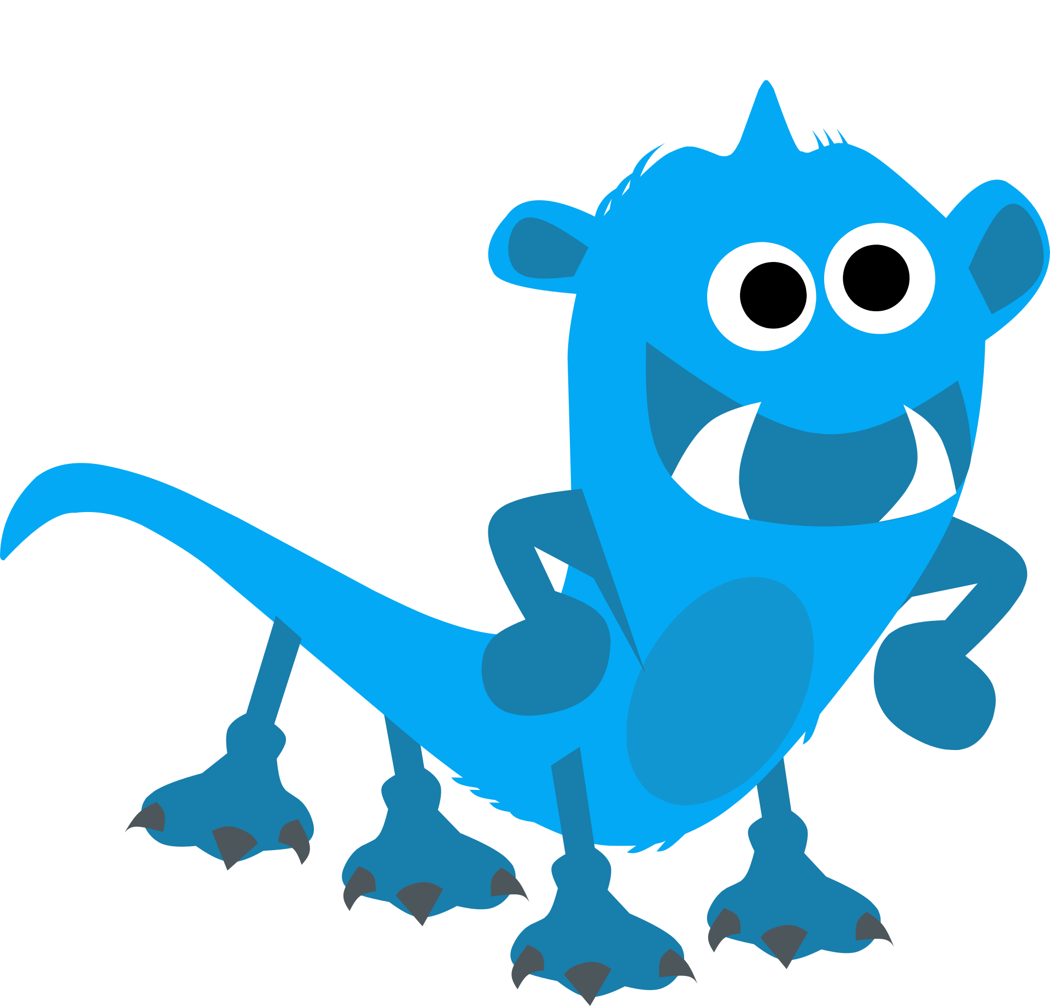
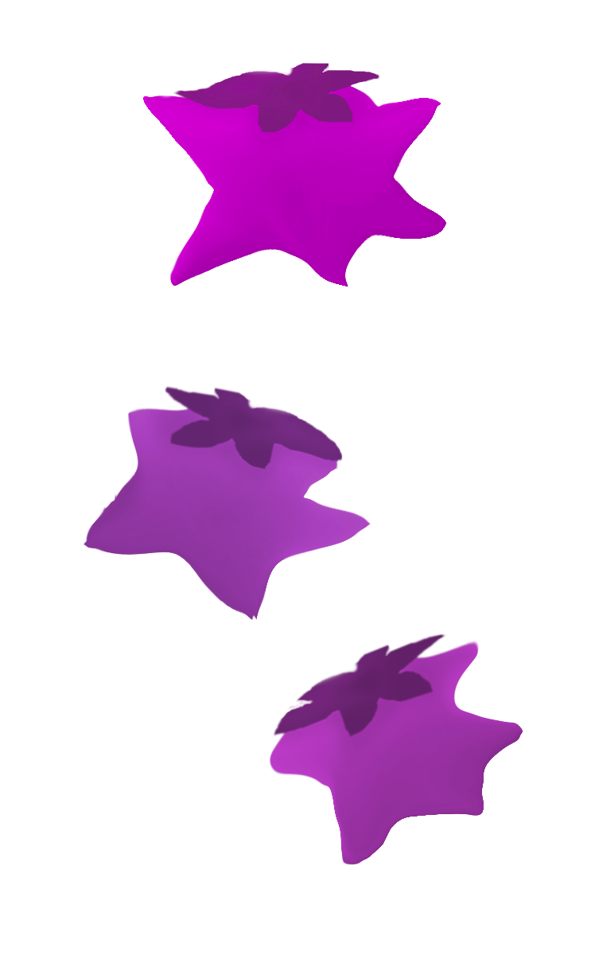
What are the downstream consequences of different construals?
Construals
adults (n=167, ~55/condition on MTurk)
children (piloting 5-8yo via online testing)
biology
culture
diet
Zarpies eat starberries.
access & availability
Notes:
Experimentally study the downstream consequences of these different construals of why groups eat certain things
Finished study with adults, about to pilot kids via online testing
Induce 3 different construals via different explanations

Slide 10
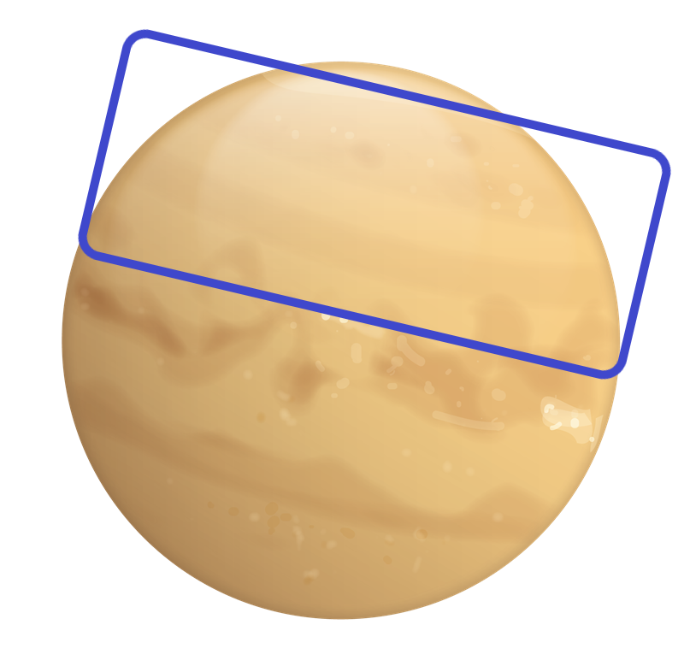
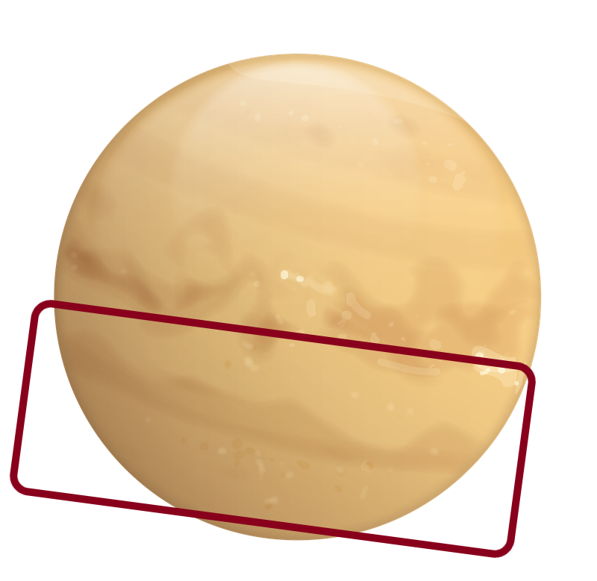
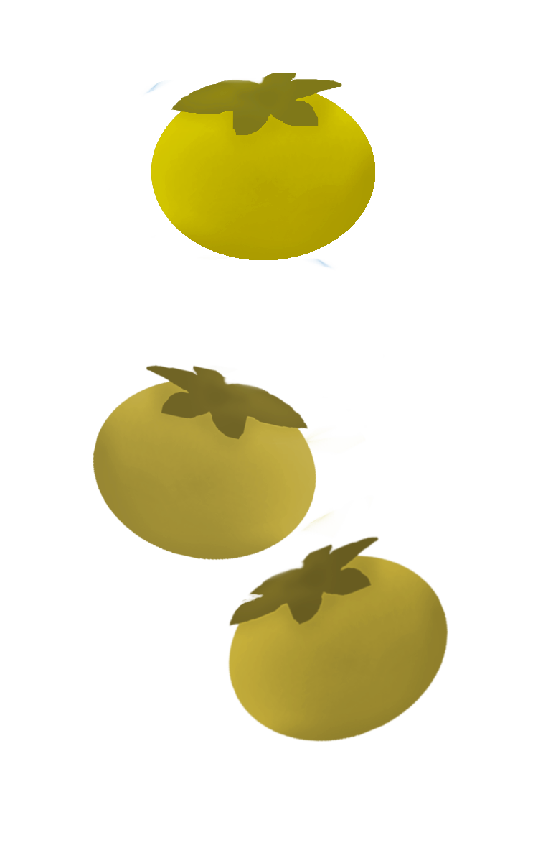

What are the downstream consequences of different construals?
Construals
adults (n=167, ~55/condition on MTurk)
children (pilot 5-8yo via online testing)
Zarpies live on this side of the planet… Vawns live on the other side of the planet.
Zarpies eat starberries. Vawns eat roundberries.
Biological
Diet
Because of the way their bodies work, other berries make them sick, so …
Zarpies eat starberries.
Cultural
Because they believe eating other berries is bad luck, …
Structural
Because starberries are the only berries that grow in the area where they live, …
Notes:
Receive 3 different kinds of explanations, which induce 3 different construals
Between-subjects
Adults and children largely the same, adjustments for children in navy
For kids: counterbalance images of two groups, labels of two groups, which group eats the purple star vs yellow round

Slide 11
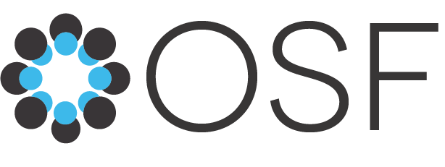
What are the downstream consequences of different construals?
Construals
Consequences
adults (n=167, ~55/condition on MTurk)
children (pilot 5-8yo via online testing)
Possibility of change
Possible for Zarpies to have a different diet?
biological ~ cultural < structural
Zarpies live on this side of the planet… Vawns live….
Zarpies eat starberries. Vawns eat roundberries.
Generalization
Expect all Zarpies to share the same diet?
biological > cultural > structural
Biological
Diet
Because of the way their bodies work, other berries make them sick, so …
Zarpies eat starberries.
Normativity
Disapprove if a Zarpie had a different diet?
biological > cultural > structural
Cultural
Because they believe eating other berries is bad luck, …
Target of intervention
To change their diet, what would you intervene on?
Biological: Zarpies’ biology
Cultural: Zarpies’ culture
Structural: berry availability
Structural
Because starberries are the only berries that grow in the area where they live, …
Notes:
Measures & predictions

Slide 12
What are the downstream consequences of different construals?
Construals
Consequences
adults (n=167, ~55/condition on MTurk)
children (pilot 5-8yo via online testing)
Possibility of change (gender stereotyping)
Which group usually eats roundberries? (Vawns)
Can Zarpies also eat roundberries? (y/n x for sure/maybe)
Zarpies live on this side of the planet… Vawns live….
Zarpies eat starberries. Vawns eat roundberries.
Generalization (switched context from essentialism)
Look, here's another Zarpie… lives on the other side of the planet. Which berries do you think this Zarpie eats? (starberries/roundberries x for sure/maybe)
Biological
Diet
Because of the way their bodies work, other berries make them sick, so
Zarpies eat starberries.
Normativity (Roberts et al., 2016)
Look, here is a Zarpie who eats roundberries!
Is it okay or not okay for this Zarpie to eat roundberries?
(okay/not okay, then a little/very: bad/good)
Cultural
Because they believe eating other berries is bad luck,
Target of intervention
starberry harvest failed this year/ storm destroyed starberries. The Zarpies need to eat roundberries.
If you could make anything happen, what would you do / what would be best to do, so that the Zarpies can eat roundberries? (open-ended, coded by target)
Structural
Because starberries are the only berries that grow in the area where they live,
Notes:
Fixed order

Slide 13
What are the downstream consequences of different construals?
Construals
Consequences*
adults (n=167, ~55/condition on MTurk)
children (pilot 5-8yo via online testing)
Structural and cultural construals lead to greater possibility of change, vs biological.
Structural construals lead to more hesitance to generalize to a category member outside of the structural context, vs cultural, vs biological.
Zarpies live on this side of the planet… Vawns live….
Zarpies eat starberries. Vawns eat roundberries.
Biological
Diet
Because of the way their bodies work, other berries make them sick, so…
Zarpies eat starberries.
Structural construals lead to less normativity about a category member who expresses a different attribute, vs cultural, vs biological.
Cultural
Because they believe eating other berries is bad luck, …
Structural construals suggest interventions targeting the structural context, while biological and cultural construals suggest interventions targeting the group.
Structural
Because starberries are the only berries that grow in the area where they live, …
*all controlled for the difficulty of intervention

Slide 14
What are the downstream consequences of different construals?
Construals
Consequences*
Structural and cultural construals lead to more possibility of change than biological.
adults (n=167, ~55/condition on MTurk)
children (pilot 5-8yo via online testing)
one-trial design
How much tied to the specific explanations (negative utility on other prop.) chosen, or specific property (diet) chosen?
→ follow-up with adults
Structural construals lead to more hesitance to generalize to a category member outside of the structural context, vs cultural, vs biological.
Zarpies live on this side of the planet… Vawns live….
Zarpies eat starberries. Vawns eat roundberries.
Biological
Diet
Because of the way their bodies work, other berries make them sick, so …
Zarpies eat starberries.
Structural construals lead to less normativity about a category member who expresses a different attribute than cultural, than biological.
Cultural
Because they believe eating other berries is bad luck, …
Structural construals suggest interventions targeting the structural context, while biological and cultural construals suggest interventions targeting the group.
Structural
Because starberries are the only berries that grow in the area where they live, …
*all controlled for the difficulty of intervention
Notes:
One-trial design – how much about these specific explanations you chose, how much about diet
Follow-up with adults, property with more hefty real-world implications
*hopefully in time for an abstract for cogsci or spp

Slide 15
Study 2: occupation
adults (planned)
Notes:
Tougher test case
Diet can be more clearly biological and cultural

Slide 16
Attributing different causes for group’s occupation patterns
Sherpa people & mountaineering (more hemoglobin)
Japanese women & pearl fishing (more body fat)
women & factory work (“nimble fingers”, “detail-oriented”, docile)
men & tech (“smarter”)
Black people & sports (“stronger”)
Chinese-Americans & restaurants
Latino men & farm workers
Latina women & domestic workers
POC & essential workers (language barrier, limited resources, stereotyping, economic discrimination)
(social networks, weak ties)
Asians & math
(math drills, families value math)
Chinese people & martial arts
(Orientialism, exoticism)
biology
culture
structural
within individual
within group
external to group
occupation
Notes:
Some of these are historical narratives used to limit the opportunities of certain groups, push them into particular occupations

Slide 17
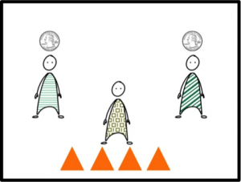
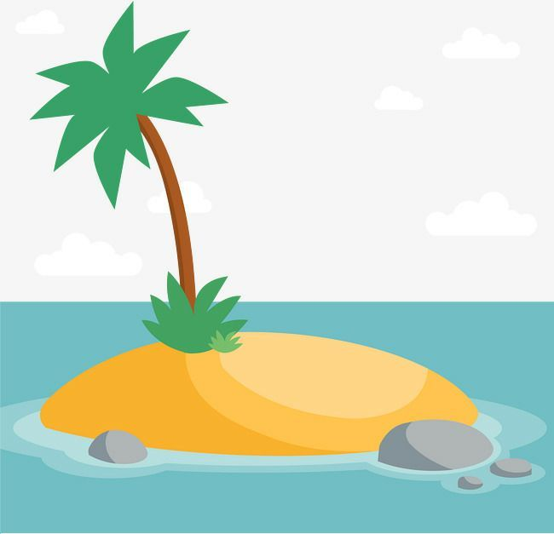
What are the downstream consequences of different construals?
Construals
island far away
many groups of people who live on this island, e.g. Zarpies, Vawns
Zarpies work as aquafruit farmers.
Aquafruit are fruit grow underwater off the coast of islands in this area, and can be sold for $0.50 each.
Zarpies dive into the ocean near the island to harvest aquafruit, typically harvesting 100 a day, although it can be dangerous to dive deep underwater for long periods of time.
Vawns work as terrafruit farmers.
Terrafruit are fruit that grow on bushes on islands in this area, and can be sold for $2 each.
Vawns go through bushes on the island to harvest terrafruit, typically harvesting 100 a day.
Job
Biological
Zarpies work as aquafruit farmers, and don't often work other jobs, because…
Zarpies have very large lungs as well as big hands and feet that are good for swimming and diving.
Cultural
Zarpies revere the ocean as a primordial source of life, and consider growing aquafruit to be a sacred job.
Structural (Vasilyeva et al., 2020)
Zarpies must fill out complex and expensive paperwork because the gov requires Zarpies to do so, in order to be hired in other jobs.
Notes:
*Ellen: contrast occupation seems very similar; *multiple ppl: +high power position (Mika/Mercedes: price/wages, Ellen: occupational risk/danger)
*Nicky: biological – should be plausibly imposed, webbed feet breaks that
*Aaron: structural – foreground system as agent
*Aaron: diet seems more deterministic, occupation seems less so
*Kayla: w kids?

Slide 18
What are the downstream consequences of different construals?
Construals
Consequences
island far away
many groups of people who live on this island, e.g. Zarpies, Vawns
Possibility of change
Possible for Zarpies to have a different occupation?
biological ~ cultural < structural
Zarpies work as aquafruit farmers.
Aquafruit are fruit grow underwater off the coast of islands in this area, and can be sold for $0.50 each.
Zarpies dive into the ocean near the island to harvest aquafruit, typically harvesting 100 a day, although it can be dangerous to dive deep underwater for long periods of time.
Generalization
Expect all Zarpies to have same occupation?
biological < cultural < structural
Job
Biological
Zarpies work as aquafruit farmers, and don't often work other jobs, because…
Zarpies have very large lungs as well as big hands and feet that are good for swimming and diving.
Normativity
Disapprove if a Zarpie had a different occupation?
biological > cultural > structural
Cultural
Zarpies revere the ocean as a primordial source of life, and consider growing aquafruit to be a sacred job.
Structural (Vasilyeva et al., 2020)
Target of intervention
To change their occupation, intervene on…?
biology vs culture vs restrictive paperwork
Zarpies must fill out complex and expensive paperwork because the gov requires Zarpies to do so, in order to be hired in other jobs.

Slide 19
What are the downstream consequences of different construals?
Construals
Consequences
island far away
many groups of people who live on this island, e.g. Zarpies, Vawns
Possibility of change
Which group usually harvests terrafruit? (V) Can Zarpies also harvest terrafruit? (Y/N x for sure/maybe)
Zarpies work as aquafruit farmers.
Aquafruit are fruit grow underwater off the coast of islands in this area, and can be sold for $0.50 each.
Zarpies dive into the ocean near the island to harvest aquafruit, typically harvesting 100 a day, although it can be dangerous to dive deep underwater for long periods of time.
Generalization
This Zarpie lives on a different nearby island. Which job do you think this Zarpie works? (harvesting aqua/terra)
Job
Biological
Zarpies work as aquafruit farmers, and don't often work other jobs, because…
Zarpies tolerate cold well, and have large lungs and big hands and feet, so they are suited for swimming and diving.
Normativity
This Zarpie is working as a terrafruit farmer. Is it okay or not okay for this Zarpie to work as a terrafruit farmer?
Cultural
Zarpies revere the ocean as a primordial source of life, and consider growing aquafruit to be a sacred job.
Target of intervention
Oil spill destroyed aquafruit this year… what would you do, so that Zarpies can work as terrafruit farmers?
Structural (Vasilyeva et al., 2020)
Zarpies must fill out complex and expensive paperwork because the gov requires Zarpies to do so, in order to be hired in other jobs.
Notes:
*Aaron: normativity measure - negative utility vs moral wrong -> trying to isolate the latter
*normativity measure – interaction w high power/wages position
*Ellen: target of intervention – what would biological condition say?

Slide 20
Backslides

Slide 21
What are the downstream consequences of different construals?
Calibration > Intro/contrast > Construal > Possibility of change > Switched context > Normativity > Intervention
N = 197 US-based adults on MTurk
N = 167 after exclusions (attention checks) (~55/condition)
In this task, you'll read a story about groups that live on a planet far far away. Please read the story carefully. You'll be asked to answer some questions about the groups.
We hope the task can be done at a future point by children, so the language is designed to be kid-friendly.
Notes:
Very fresh pilot data, excited for your thoughts. Pilot w adults, goal is eventually to test with kids, 5-6yo
(click) high-level overview is that we introduce participants to novel social groups and novel property of those social groups, participants are randomly assigned to hear one of 3 kinds of explanations inducing biological, cultural, or structural construal, 3 measures in fixed order
Based on a simulation power analysis, ran 150 adults on MTurk, 132 after exclusions.
Run you through the study and predictions, then show you the data
Participants saw everything indicated in the boxes

Slide 22
What are the downstream consequences of different construals?
Calibration > Intro/contrast > Construal > Possibility of change > Switched context > Normativity > Intervention
Let's get started by practicing with some questions.
Can people shower in the morning instead of at night? (Y/N)
Can people walk through walls? (Y/N)
Is it okay or not okay if someone falls down the stairs? (okay/not okay)
Is it okay or not okay if someone gives a gift to their friend? (okay/not okay)
Calibrate
Possibility of change
Normativity
Feedback for each
Actually, no. / That’s right!
People can't walk through walls, because walls are solid and we can't pass through them.
N = 167 adults on MTurk
~55/condition
Notes:
Calibration questions
Normativity: wide range, stats norm, moral

Slide 23
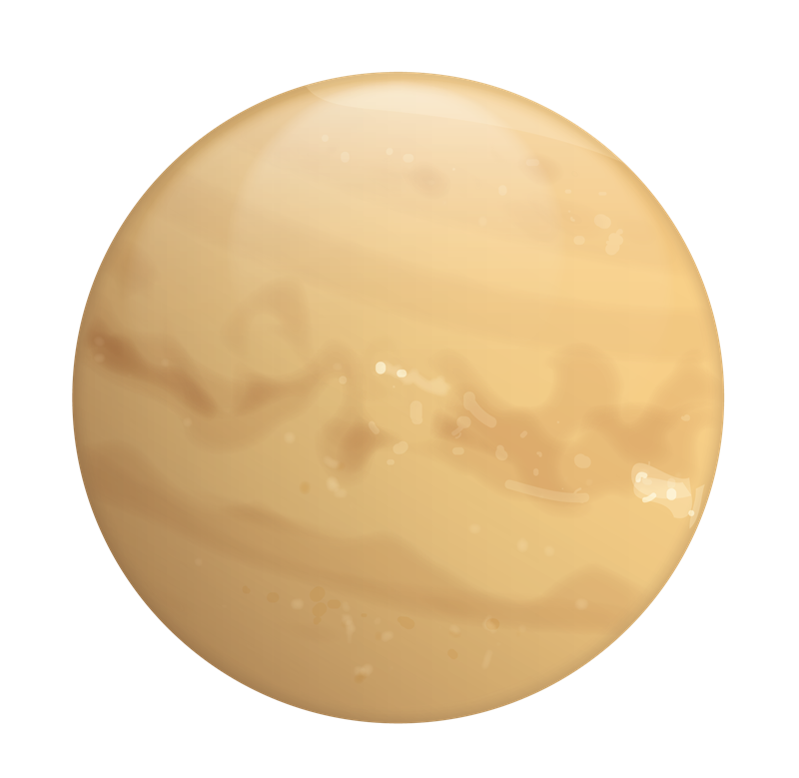
What are the downstream consequences of different construals?
Calibration > Intro/contrast > Construal > Possibility of change > Switched context > Normativity > Intervention
Great, let's get started!
I am going to tell you about a planet far away.
novel setting
N = 167 adults on MTurk
~55/condition

Slide 24
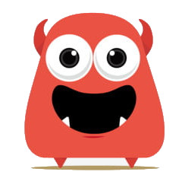
What are the downstream consequences of different construals?
Calibration > Intro/contrast > Construal > Possibility of change > Switched context > Normativity > Intervention
There are 2 kinds of friendly aliens who live on this planet: Zarpies and Vawns.
novel social groups
N = 167 adults on MTurk
~55/condition
Notes:
Novel social groups

Slide 25
What are the downstream consequences of different construals?
Calibration > Intro/contrast > Construal > Possibility of change > Switched context > Normativity > Intervention
Zarpies live here, on this side of the planet.
structural context
N = 167 adults on MTurk
~55/condition
Notes:
Structural context: environmental/residental segregation

Slide 26
What are the downstream consequences of different construals?
Calibration > Intro/contrast > Construal > Possibility of change > Switched context > Normativity > Intervention
Vawns live here, on this other side of the planet.
structural context
N = 167 adults on MTurk
~55/condition
Notes:
Structural context: environmental/residental segregation

Slide 27
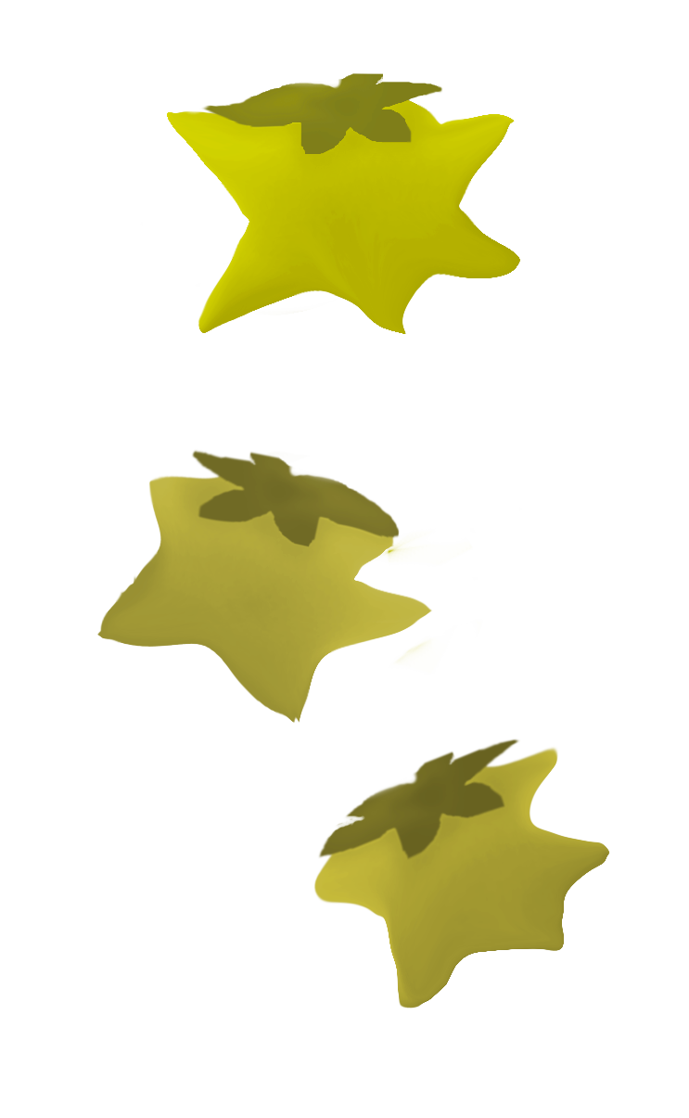
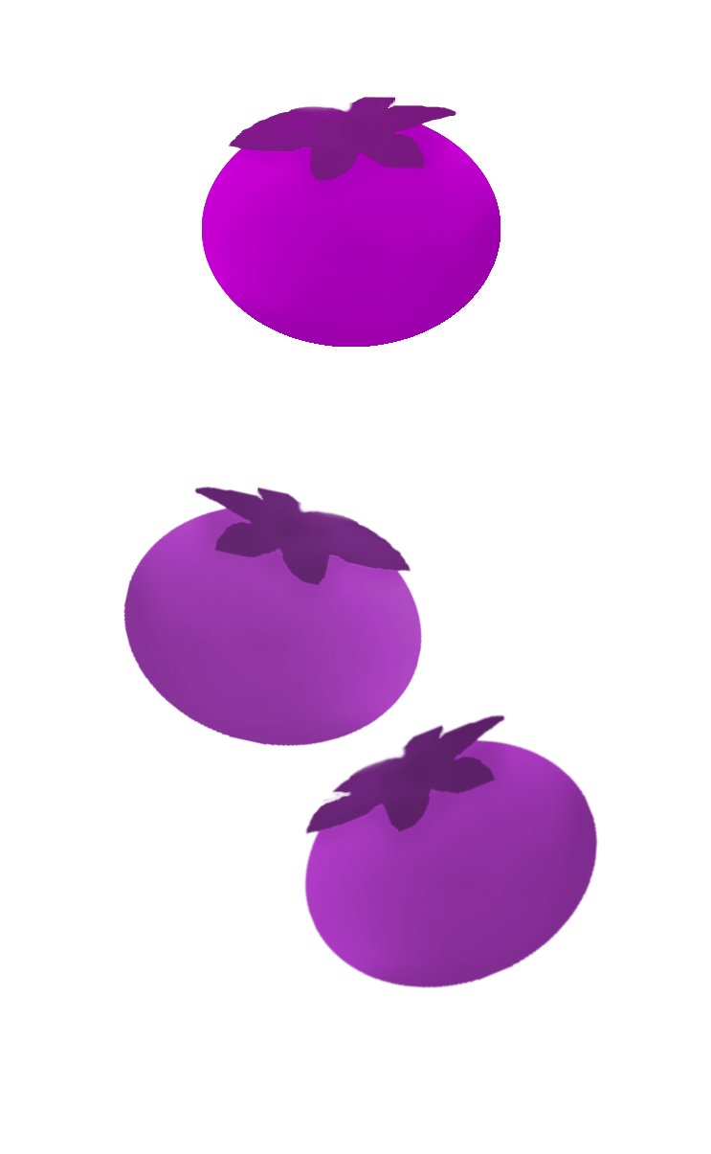
What are the downstream consequences of different construals?
Calibration > Intro/contrast > Construal > Possibility of change > Switched context > Normativity > Intervention
Zarpies eat starberries. Vawns eat roundberries.
& novel neutral property
Generic statements:
convey relative frequency (Tessler & Goodman, 2019)
support multiple construals (Noyes & Keil, 2019/2020, Vasilyeva & Lombrozo, 2020)
N = 167 adults on MTurk
~55/condition
Notes:
Introduce a neutral novel property (eating berries) using generic statements.
We know from other work (MH Tessler) that generics can support various kinds of construals, and principly communicate that the idea that this category has a relatively higher frequency of this property than contrast categories. Sets up the disproportionate contrast we saw earlier with real-life examples

Slide 28
What are the downstream consequences of different construals?
Calibration > Intro/contrast > Construal > Possibility of change > Switched context > Normativity > Intervention
Today we're going to learn about Zarpies!
N = 167 adults on MTurk
~55/condition
Notes:
Focus on a single group

Slide 29
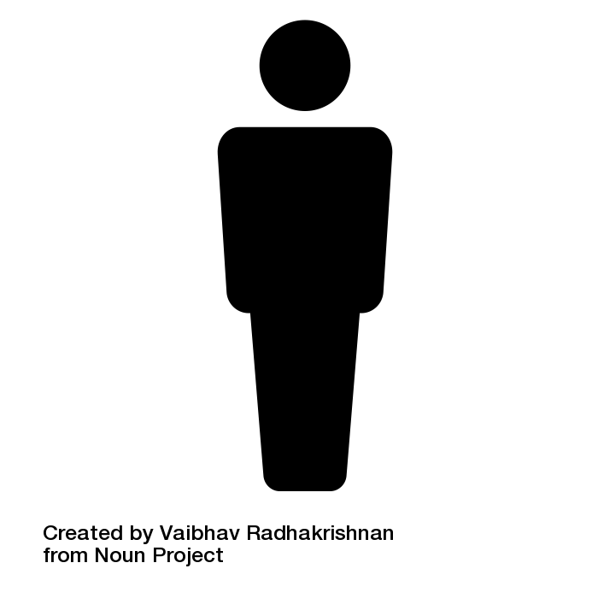
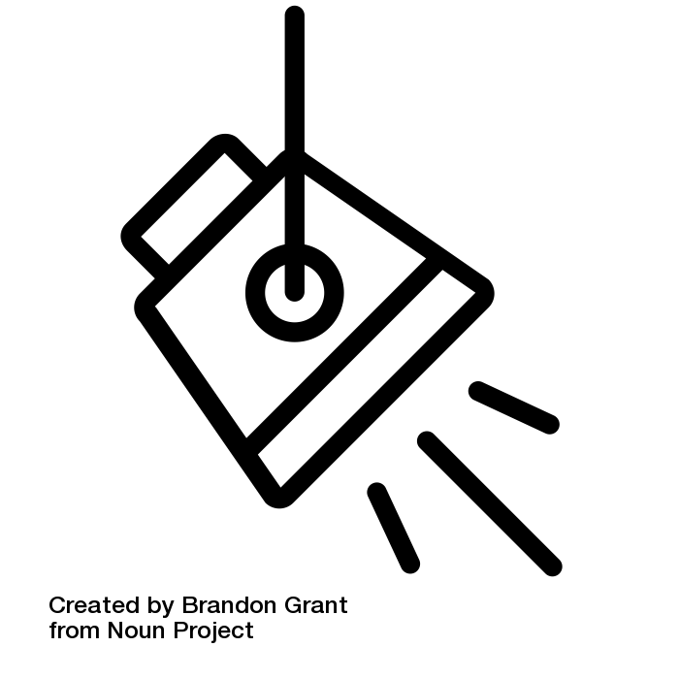
What are the downstream consequences of different construals?
Calibration > Intro/contrast > Construal > Possibility of change > Switched context > Normativity > Intervention
Participants randomly assigned to 1 of 3 conditions:
Internalist (biological)
Because of the way their bodies work, other berries make them sick, so…
Diet
biology
Zarpies
only eat starberries.
cultural taboos
Internalist (cultural)
Because they believe eating other berries is bad luck,
availability / access
Structural
Because pogoberries are the only berries that grow in the area where they live…
eat pogoberries
Notes:
Receive 3 different kinds of explanations, which induce 3 different construals

Slide 30
What are the downstream consequences of different construals?
Calibration > Intro/contrast > Construal > Possibility of change > Switched context > Normativity > Intervention
Attention check (n=9 excluded)
Which group usually eats roundberries?
(Zarpies,
Vawns)

Slide 31
What are the downstream consequences of different construals?
Calibration > Intro/contrast > Construal > Possibility of change > Switched context > Normativity > Intervention
Possibility of change
From traditional flexibility measures in development of gender stereotypes (Levy et al., 1995, Blakemore & Russ, 1997)
Can Zarpies also eat roundberries?
?
(For sure no, Maybe no, Maybe yes, For sure yes)
Notes:
Possibility of change – is it possible for category members to be otherwise?
Modeled from gender stereotype dev literature (Levy et al, 1995, Blakemore & Russ, 1997). Traditional flexibility – whether gender/moral/social transgression is possible. Follows rule knowledge: “Which group usually plays with a toy kitchen? (boys/girls). Can boys also play with a toy kitchen? (Y/N)
Possibi

Slide 32
What are the downstream consequences of different construals?
Calibration > Intro/contrast > Construal > Possibility of change > Switched context > Normativity > Intervention
Switched context (essentialism literature)
Look, here's another Zarpie. This Zarpie lives on the other side of the planet. Which berries do you think this Zarpie eats?
(Starberries, Roundberries)
4-point:
(Maybe,
For sure)
(Maybe,
For sure)

Slide 33
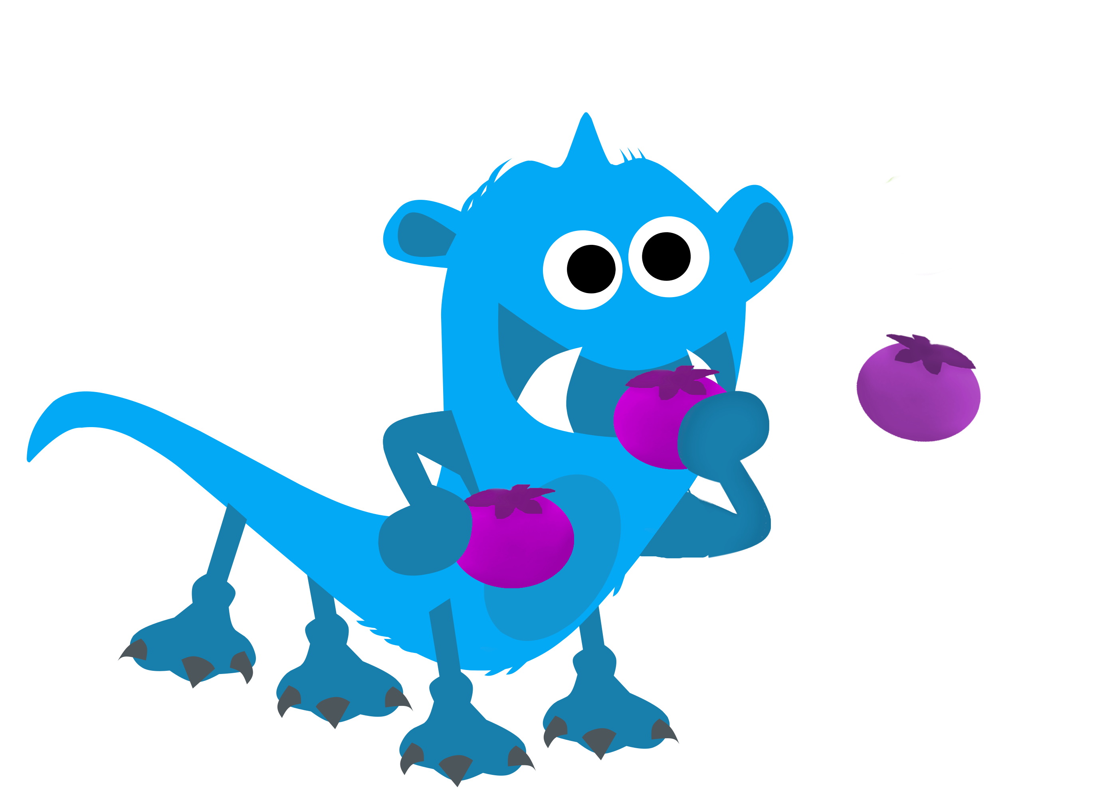
What are the downstream consequences of different construals?
Calibration > Intro/contrast > Construal > Possibility of change > Switched context > Normativity > Intervention
Normativity (Roberts et al., 2016)
Look, here is a Zarpie who eats roundberries!
Is it okay or not okay for this Zarpie to eat roundberries?
forced-choice:
(Okay, Not okay)
(Very, very good, Pretty good, A little good)
(A little bad, Pretty bad, Very, very bad)
6-point:
Notes:
2-step scale used extensively with 4-11yo by Steven
*who is eating okinberries
Roberts, S. O., Gelman, S. A., & Ho, A. K. (2016). So It Is, So It Shall Be: Group Regularities License Children’s Prescriptive Judgments. Cognitive Science, 41(S3), 576–600. https://doi.org/10.1111/cogs.12443

Slide 34
What are the downstream consequences of different construals?
Calibration > Intro/contrast > Construal > Possibility of change > Switched context > Normativity > Intervention
Target of intervention
5-8yo
Adults
Every year, the Zarpies grow starberries. This year a big storm came, and oh no, destroyed all the starberries! Now the Zarpies don’t have any starberries to eat. The Zarpies are getting hungry and they’ll need your help… We’ll need to get the Zarpies to eat roundberries instead.
If you could make anything happen, what would be the best thing to do, so that the Zarpies can eat roundberries?
Oh no, the pogoberry harvest failed this year. The Zarpies need to eat okinberries.
If you could make anything happen, what would you do, so that the Zarpies can eat okinberries? Please list at least 1 specific action you would do.
open-ended
coding:
Modify Zarpies biology (give pill, vaccine to Zarpies)
Modify Zarpies’ beliefs/culture (teach Zarpies, tell Zarpies)
Modify roundberries (cook roundberries, paint roundberries)
Acquire roundberries (migrate to other side, import/trade from Vawns)

Slide 35
What are the downstream consequences of different construals?
Calibration > Intro/contrast > Construal > Possibility of change > Normativity > Intervention
Difficulty of intervention
Adults
5-8yo
How easy or difficult would it be to do the action you suggested above? If you suggested more than one action, just rate the first action you listed.
(Very easy, Somewhat easy, Somewhat difficult, Very difficult)
Would it be easy or hard to (describe what they just suggested)?
4-point:
(Easy/Hard)
(A little/Very)
Notes:
Exploratory measure added in
*independent raters rate top few interventions: equated difficulty

Slide 36
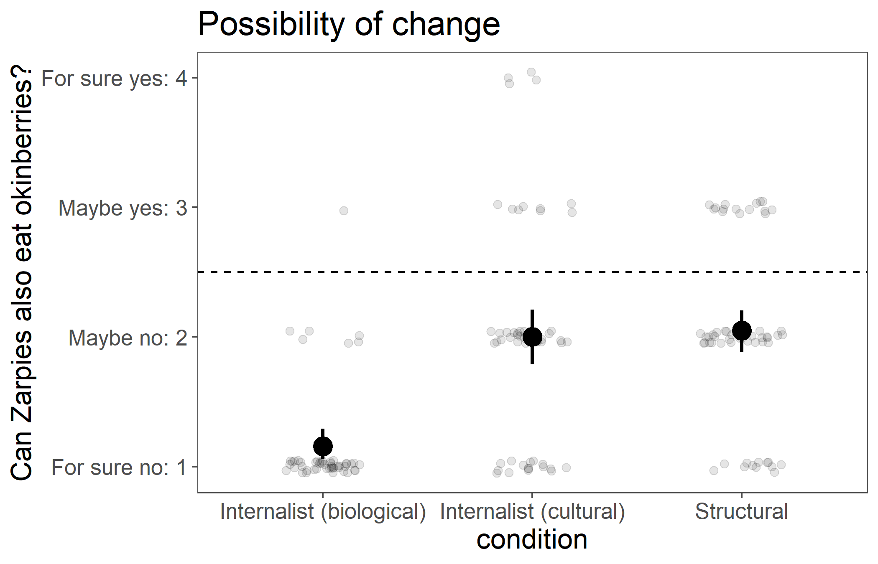
Structural and cultural construals lead to greater possibility of change than biological.
***
***
lm(possibility_change ~ condition + intervention_diff)
condition**
FDR-adjusted pairwise comparisons
= 95% bootstrap CIs
N = 192 adults on MTurk
~55/condition
Notes:
All sig diff from chance
remain significant after controlling for difficulty of intervention
*ELLEN: pretty low?
*DAVID: how are measures related? possibility judgments feed into counterfactual judgments, which drive intervention?

Slide 37
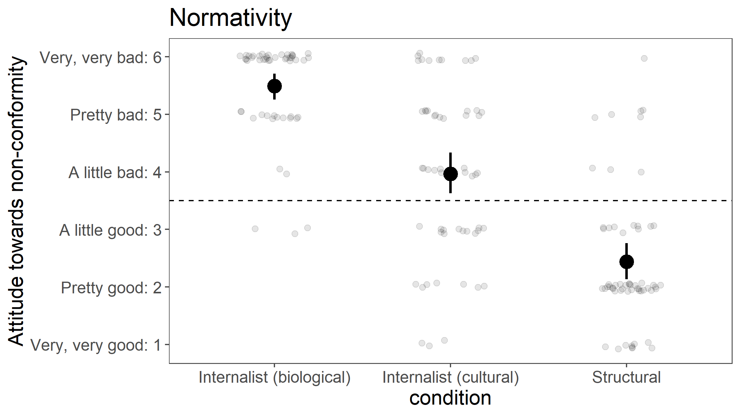
Structural construals lead to less normativity than cultural or biological.
***
***
lm(normativity ~ condition + intervention_diff)
condition**
FDR-adjusted pairwise comparisons
= 95% bootstrap CIs
N = 167 adults on MTurk
~55/condition
Notes:
Same pattern as fc

Slide 38
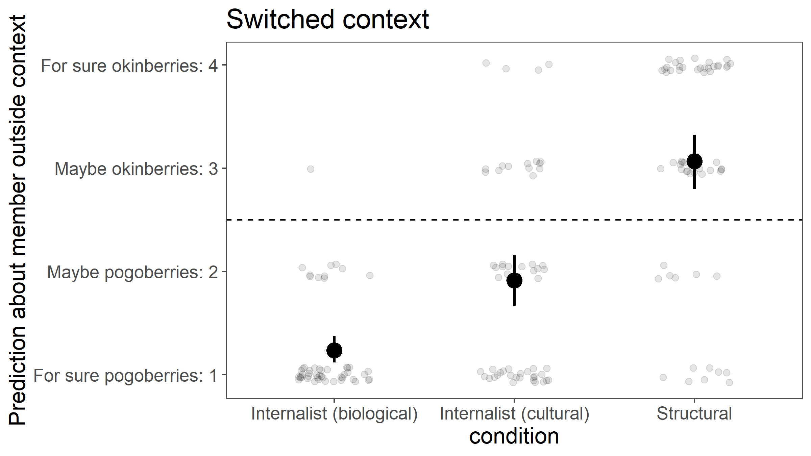
Structural construals lead to more hesitance to generalize to a category member outside of the structural context.
***
***
lm(switched_context ~ condition + intervention_diff)
condition**
FDR-adjusted pairwise comparisons
= 95% bootstrap CIs
N = 167 adults on MTurk
~55/condition
Notes:
All sig diff from chance

Slide 39
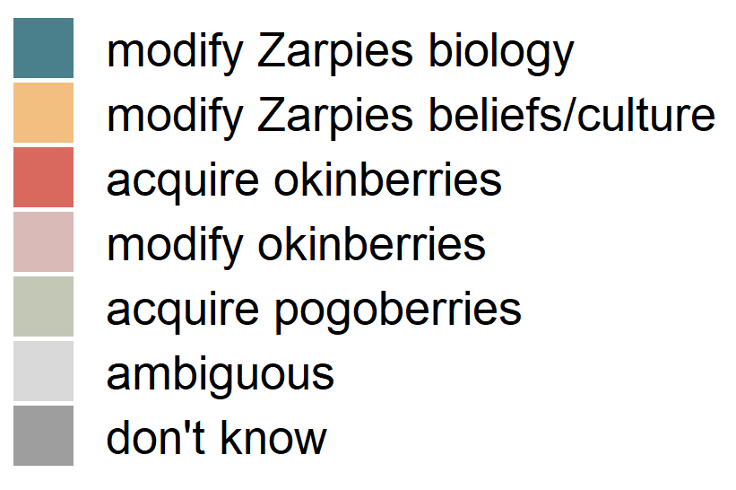
Actual interventions suggested
modify Zarpies biology
vaccine, potion, pill, medicine, build tolerance, cross-breed w another alien
modify Zarpies beliefs/culture
tell them it's not bad luck, tell them it's good luck, change their thoughts
acquire okinberries
grow/plant, import, trade, ask Vawns to send, search planet, tell them where to find, share with Vawns, travel, invade, visit Vawns, move to other side of planet, switch spots with Vawns
modify okinberries
change their color, wash them, heat up, cook them, prepare them, remove part, mix with something else, sanitize
acquire pogoberries
ambiguous
magic spell that allows them to eat okinberries, give seeds, ask someone for them, be friendly with others, make it to where the okinberries don't make the Zarpies sick, have it not be poisonous, Will harvest again and cultivate it, establish hospitals for Zarpies when they get sick, Zarpies will try to eat okinberies, too far away
don't know
N = 167 adults on MTurk
~55/condition
Notes:
What did participants come up with for intervention?
Coding scheme, just coded myself without looking at condition
Was not predicting modify okinberries

Slide 40
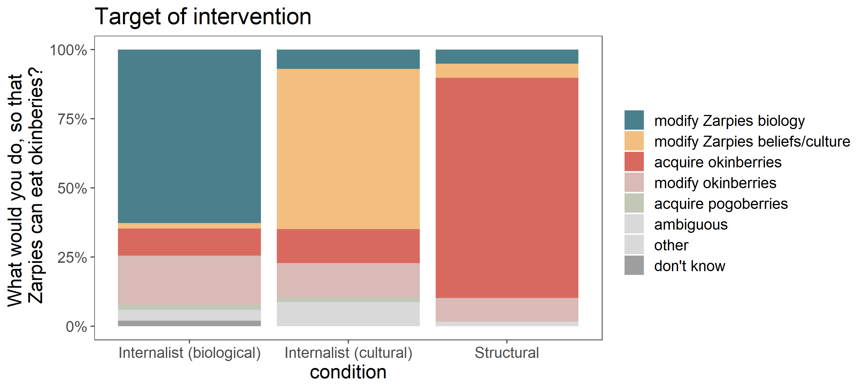
Structural construals shift the focus of intervention to the structural context.
glm(modify_Zarpies_biology ~ condition + intervention_diff,
family = "binomial“)
N = 167 adults on MTurk
~55/condition
Fisher’s exact test***
Notes:
Modify Zarpies biology: biological (~half) > cultural, structural
Modify Zarpies beliefs/culture: cultural (~half) > biological, structural
Acquire okinberries: structural (majority) > biological, cultural

Slide 41
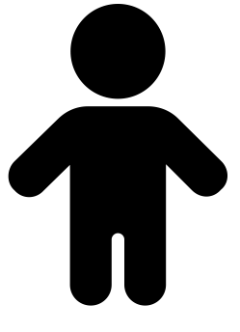
Future thoughts
Why?
Why?
Additional downstream consequences from these construals
motivation for change
Building up to more complex (and common) models with different levels and types of causes interacting with each other
When structural contexts are caused by another group
How to communicate structural construals?
+/-
Interactions with property valence
Notes:
5-6yo - likely exaggerated patterns for possibility of change (stereotype rigidity), and normativity (hair-trigger normativists in Steven’s work)
Motivation for change – here focused on whether it’s possible to change, and if you could change what would you do, but didn’t get at how motivated people would be to intervene. Social justice rn - discouraged when possibility of change seems impossible, eg system seems impossible to change
Complex models – eg even with eating habits: biology/culture interactions (eg lactose intolerance and the presence of dairy in various cuisines), culture and environmental context interactions (eg local availability of plants, ingredients used in traditional cuisines)
Property valence – examples were negative, here novel neutral property.

Slide 42
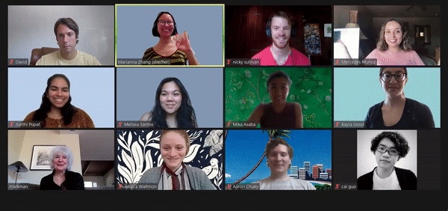


Thanks!
Thanks!
Adult pilot participants on MTurk
Markman lab meetings
Thurs 9-10:30am Pacific
on Zoom
https://mailman.stanford.edu/mailman/listinfo/markman_lab
markmanlab.stanford.edu
github.com/mariannazhang/ structural-consequences
osf.io/hz76n
mariannazhang.github.io
Notes:
devo area, cohort, dept for being so welcoming, helping me feel like I belong in community * how are generics and formal explanations related? Hunch: intimately related, open question exactly how. formal explanations do generically invoke the category. My guess is that formal explanations build on generics, going further by specifying that the category is somehow *the reason* for possessing the property, which allows them to be explanations rather than just statements. Would be interesting to probe when each are produced.
* variability at category level (what categories are essentialized), property level (what properties are essentialized for a given category, or tend to be essentialized across categories). Thinking about ess vs soc-str construals as a continuum, with intermediate
* relate to social attribution - something about the internal character, or something about the general situation. Social-structural forces aren’t just present for an individual in a one-time situation, these are stable forces acting on a category by virtue of the whole social context that it exists within
* vicious circle - social-structural context -> inherent properties, eg preference -> reinforce the very social-structural contexts that produced them (eg dept stores: lots of pink for girls' clothing, girls develop preference for pink, stores justify it in that there's demand for those clothes). structural contexts could end up reflecting something internal. Reasoning about root causes, inherence heuristic (Cimpian), statistical confound of context and inherent properties, contingency vs necessity.

